Slide 1
HUMAN PERFORMANCE COACH · FACILITATOR · RELATIONSHIP BUILDER
Building relationships
that move
people.
ZP
EXPLORER
IN MOTION
Creating environments where people reconnect with themselves,
each other, and what matters most.
NAIROBI · TORONTO · LISBON · THE WORLD
Notes:
[Sources]
- User-provided portfolio positioning and biography, 2026-07-30.
[/Sources]

Slide 2
01 · THE STORY
An explorer shaped by three places.
2003
2021
2023
NOW
NAIROBI
TORONTO
LISBON
Roots, community,
athletic spirit.
Business, psychology,
new possibility.
Portugal. Football,
injury, transformation.
The throughline is not a job title.
It is curiosity, connection, and the courage to keep moving.
ZIYAN POPATIA
02
Notes:
[Sources]
- User-provided biography: Nairobi upbringing, Toronto education, and Lisbon exchange/football experience.
[/Sources]

Slide 3
02 · THE INTERSECTION
My work lives where three forces meet.
01
02
03
Human
connection
Experience
design
Business &
relationships
Presence, emotional intelligence, trust, and the ability to read a room.
A clear journey, meaningful details, and moments people remember.
Structure, communication, partnerships, and consistent follow-through.
One human-first way of working.
ZIYAN POPATIA
03
Notes:
[Sources]
- User-provided education, professional experience, and portfolio positioning.
[/Sources]

Slide 4
03 · FACILITATION
I create spaces that move people
from doing into being.
“Hold the room.
Read the moment.
Move with purpose.”
As a Human Performance Coach and facilitator, I read the room, build trust, and guide people through regulation, focused challenge, and integration—creating the conditions for presence and flow.
300+
3,000+
OTHERSHIP · TD BANK · COMMUNITY
HOURS OF MODALITY &
FACILITATION DEVELOPMENT
PEOPLE GUIDED THROUGH
IMMERSIVE WELLNESS EXPERIENCES
ZIYAN POPATIA
04
Notes:
[Sources]
- User-provided Human Performance Coach positioning and 3,000+ people guided metric, 2026-07-30.
- User-provided Othership, TD Bank, and community facilitation experience.
[/Sources]

Slide 5
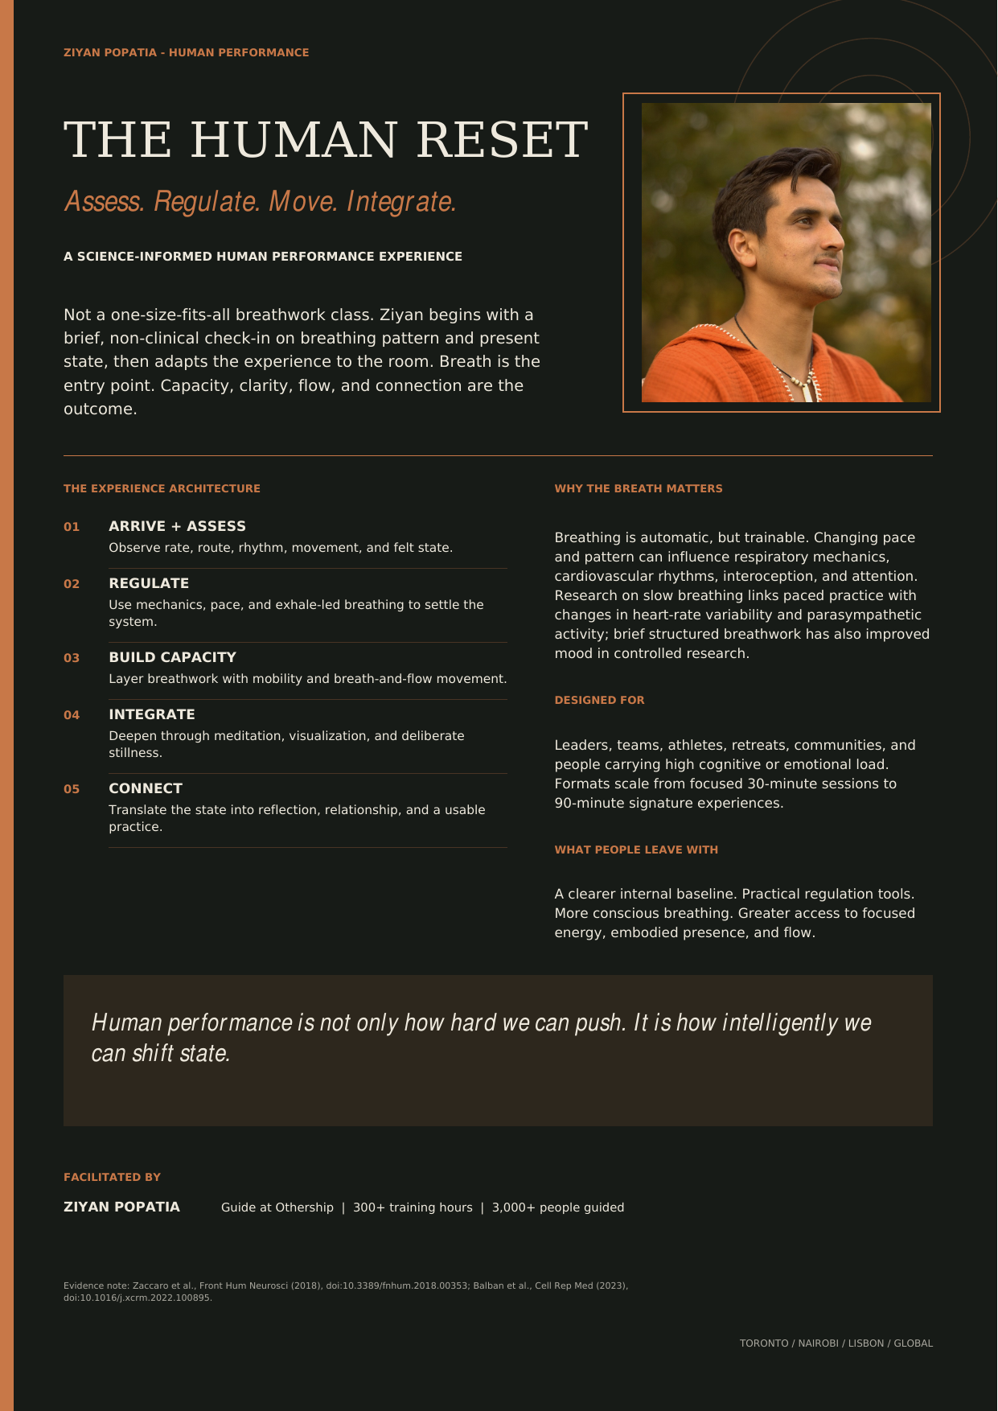
04 · SIGNATURE EXPERIENCE
The Human Reset turns
state into performance.
A science-informed, adaptable experience that begins with breath and state assessment, then moves through regulation, breath-and-flow, meditation, visualization, integration, and connection.
ROLE
Human Performance Coach
ARC
Assess · regulate · move · integrate
FORMAT
30–90 minutes · adaptable to the room
ZIYAN POPATIA
05
Notes:
[Sources]
- Zaccaro et al. (2018), slow breathing systematic review: https://doi.org/10.3389/fnhum.2018.00353
- Balban et al. (2023), randomized controlled breathwork study: https://doi.org/10.1016/j.xcrm.2022.100895
- User-provided Human Reset concept and coaching approach, 2026-07-30.
[/Sources]

Slide 6
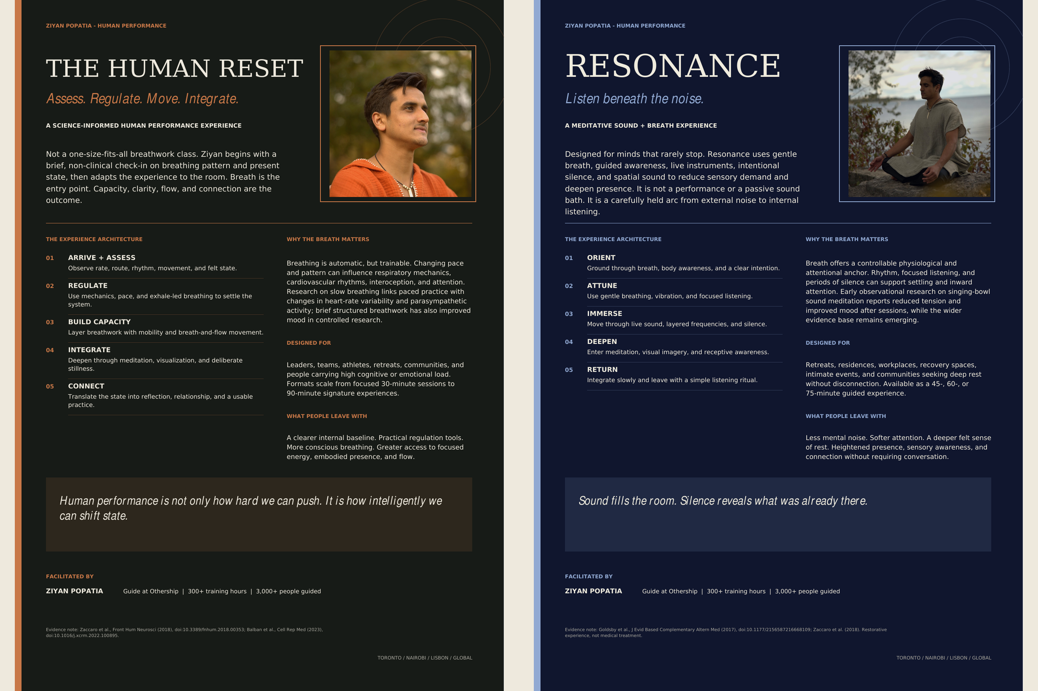
05 · EXPERIENCE DESIGN
Two expressions. One human-first system.
The Human Reset builds capacity. Resonance deepens rest through sound, breath, and silence.
ASSESS · REGULATE · FLOW · SOUND · STILLNESS · PRESENCE
ZIYAN POPATIA
06
Notes:
[Sources]
- Goldsby et al. (2017), observational singing bowl sound meditation study: https://doi.org/10.1177/2156587216668109
- User-provided Resonance sound-and-breath experience concept, 2026-07-30.
- User-owned portfolio imagery.
[/Sources]

Slide 7
06 · BUSINESS FOUNDATION
Experience operations taught me
to turn vision into delivery.
TRIPARC · NAVIGATR GROUP
Sales & Operations
Commercial analysis, process improvement, cross-functional work, and digital brand experience.
KENSINGTON TOURS
Groups & Ultralux
Global coordination, client-ready storytelling, high-touch service, and destination-partner collaboration.
People feel the experience. Strong operations make it possible.
ZIYAN POPATIA
07
Notes:
[Sources]
- User-provided TripArc and Kensington Tours professional experience and current résumé.
[/Sources]

Slide 8
07 · RELATIONSHIP BUILDING
My value is relational.
The work begins before the pitch and continues after the introduction.
RELATIONSHIPS
OVER
TRANSACTIONS
01
LISTEN
Understand what matters beneath the surface.
02
CONNECT
Recognize the right people, ideas, and energy.
03
BUILD TRUST
Communicate with clarity, care, and integrity.
04
FOLLOW THROUGH
Turn good conversations into meaningful movement.
ZIYAN POPATIA
08
Notes:
[Sources]
- User-provided positioning for relationship-led sales, partnerships, retreat work, and Circolo/Kalma opportunity.
[/Sources]

Slide 9
08 · WHERE I CREATE VALUE NEXT
Two paths. One contribution.
Whether I am inside the experience or building the relationships around it, I help people feel connected to the purpose.
01
02
Retreats &
facilitation
Partnerships &
relationships
Hold meaningful spaces, shape the guest journey, collaborate with facilitators, and bring emotional range to global retreats.
Open doors, cultivate aligned partners, represent the vision with integrity, and help turn relationships into sustainable growth.
IN THE ROOM
AROUND THE EXPERIENCE
ZIYAN POPATIA
09
Notes:
[Sources]
- User-provided two-path portfolio direction: retreat facilitation and relationship/partnership development.
[/Sources]

Slide 10
LET'S BUILD SOMETHING MEANINGFUL
Have a room,
a vision, or an idea?
ZP
I am open to conversations around retreats, corporate wellbeing, facilitation, partnerships, and experience-led growth.
CREATE TRUST · MOVE WITH PURPOSE
INSTAGRAM · @ZIYAN.POPATIA
WEBSITE · LIVE PORTFOLIO
TORONTO · NAIROBI · LISBON · GLOBAL
Notes:
[Sources]
- User-provided professional direction and location.
- Instagram: https://www.instagram.com/ziyan.popatia/
[/Sources]

